Slide 1
Project Overview

Slide 2
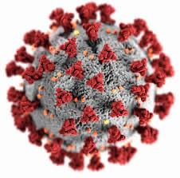
Covid-19 Prediction/ Reporting

Slide 3

Data Lake
Data Lake to be built with the following data to aid Data Scientists to predict the spread of the virus/ mortality
Confirmed cases
Mortality
Hospitalization/ ICU Cases Testing Numbers
Country’s population by age group

Slide 4
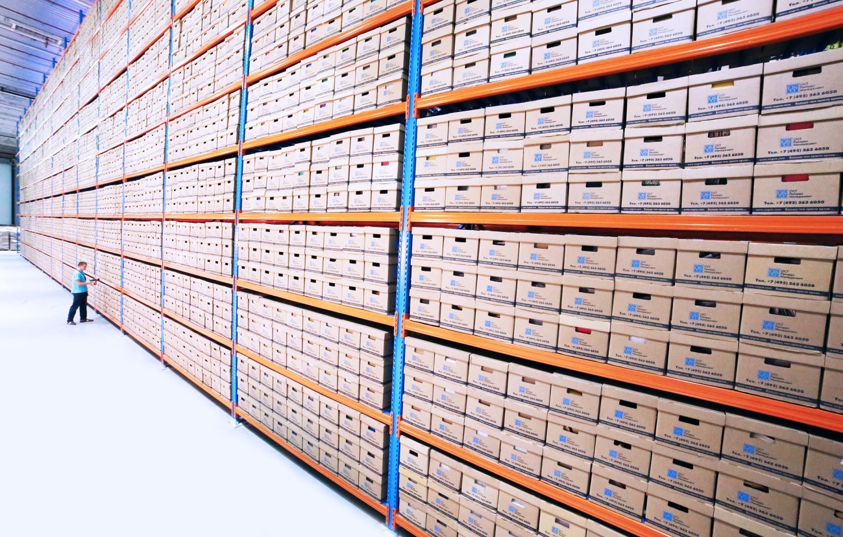
Data Warehouse to be built with the following data to aid Reporting on Trends
Data Warehouse
Confirmed cases
Mortality
Hospitalization/ ICU Cases Testing Numbers

Slide 5













Solution Architecture
Transformation
ECDC COVD-19
data (HTTP Connector)
Ingest
Transform/ Analyze
Publish
Azure Data Lake Storage Gen2
Azure SQL Database
Population Data (Azure Blob Storage)
Azure Data Lake Storage Gen2
ML Models

Slide 6
Population By Age
Ingest “population by age” for all EU countries to data lake to support ML models to predict mortality rates.

Slide 7



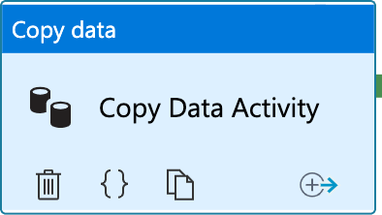

Copy Activity
Source
Sink
Azure Blob Storage
Azure Data Lake
Source File (Zipped TSV)
Target File (TSV)
Copy Activity

Slide 8

Copy Activity From Azure Blob Storage

Slide 9









Copy Activity
Pipeline
5
Source
Sink
1
ls_ablob_covidreportingsa
2
ds_population_raw_gz
1
3
Linked Service
Azure Blob Storage
Linked Service
Azure Data Lake
3
ls_adls_covidreportingdl
4
ds_population_raw_tsv
Source File (Zipped TSV)
2
4
Target File (TSV)
Source Data Set
Copy Activity
6
Sink Data Set
5
pl_ingest_population_data
Storage Account: covidreportingdl Container: raw
File: population/population_by_age.tsv
6
Copy Population Data
Storage Account: covidreportingsa Container: population
File: population_by_age.tsv.gz

Slide 10
Scenario 1
Execute Copy Activity when the file becomes available

Slide 11
Scenario 2
Execute Copy Activity only if file contents are as expected

Slide 12
Scenario 3
Delete the source file on successful copy

Slide 13
Data Ingestion Requirement
Covid 19 – new cases and deaths by country
Covid 19 – Hospital admissions and ICU cases
Covid 19 – Testing Numbers
Covid 19 – Country Response to Covid 19
URL- Download COVID-19 data (europa.eu)

Slide 14
Data Ingestion
Case & Deaths Data
URL - https://www.ecdc.europa.eu/en/publications-data/data-national-14-day-notification-rate-covid-19

Slide 15




Copy Activity – Case & Deaths Data
Pipeline
5
ls_http_opendata_ecdc_eu ropa_eu
Source
Sink
1
2
ds_cases_deaths_raw_csv
_http
1
3
Linked Service
HTTP
Linked Service
Azure Data Lake
3
ls_adls_covidreportingdl
4
ds_cases_deaths_raw_csv
_dl
Source File (CSV)
2
4
Target File (CSV)
Source Data Set
Copy Activity
6
Sink Data Set
5
pl_ingest_cases_deaths_d ata
6
Copy Cases And Deaths Data
URL:
https://opendata.ecdc.europa.eu/covid19/nationalcasedeath/csv
Storage Account: covidreportingdl Container: raw
File: ecdc/cases_deaths.csv

Slide 16


Copy Activity – Hospital Admission Data
Pipeline
5
ls_http_opendata_ecdc_eu ropa_eu
Source
Sink
1
2
ds_hospital_admissions_ra w_csv_http
1
3
Linked Service
HTTP
Linked Service
Azure Data Lake
3
ls_adls_covidreportingdl
4
ds_hospital_admissions_ra w_csv_dl
Source File (CSV)
2
4
Target File (CSV)
Source Data Set
Copy Activity
6
Sink Data Set
5
pl_ingest_hospital_admissi ons_data
6
Copy Hospital Admissions Data
URL:
https://opendata.ecdc.europa.eu/covid19/hospitalicuadmission rates/csv/data.csv
Storage Account: covidreportingdl Container: raw
File: ecdc/hospital_admissions.csv

Slide 17
Data Flows (1) - Module Overview (Cases & Deaths File)

Slide 18
Data Flow – Cases & Deaths Data
Transformation
ECDC COVD-19
data (HTTP Connector)
Ingest
Transform/ Analyze
Publish
Azure Data Lake Storage Gen2
Azure SQL Database
Population Data (Azure Blob Storage)
Azure Data Lake Storage Gen2
ML Models

Slide 19
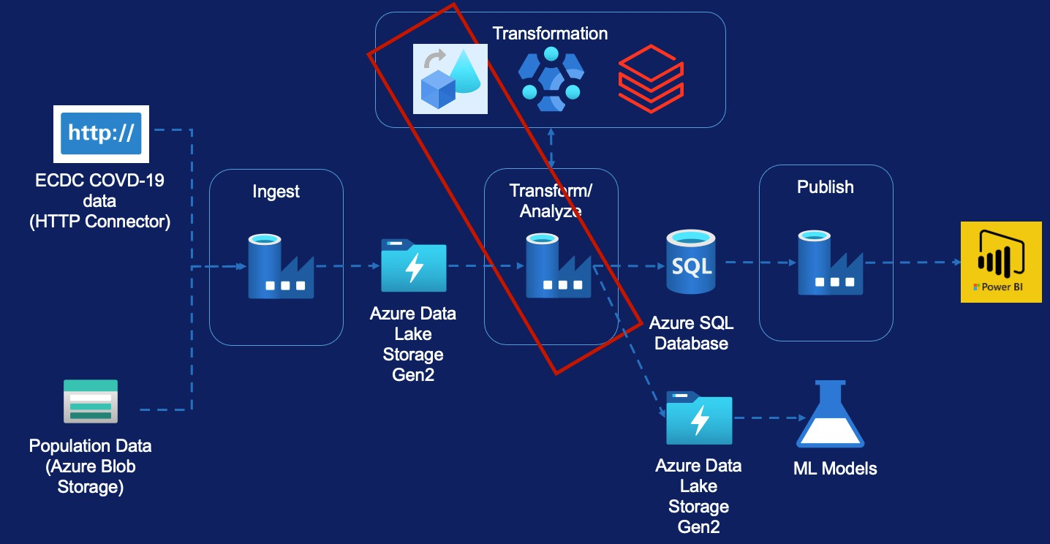
Data Flow – Cases & Deaths Data
Data Flow Overview
Requirement
Source Transformation Filter Transformation Select Transformation Pivot Transformation Lookup Transformation Sink Transformation Create Pipeline

Slide 20

Transform Cases & Deaths Data

Slide 21

Transform Cases & Deaths Data
Europe Only
Raw File from ECDC
Transformed File
Column Name
country
country_code
continent
population
indicator
daily_count
date
rate_14_day
source
Column Name
country
country_code_2_digit(Lookup)
country_code_3_digit
population
cases_count
deaths_count
reported_date
source
Notes:
Lookup country in lookup file, whether its two or three digit
Indicator and daily_count does not confirm whether its daily mortality count or confirmed case count by using the column so pivot the data to get count based on values available in the columns

Slide 22
Data Flows (2) - Module Overview (Hospital Admissions File)

Slide 23
Data Flow – Hospital submission Data
Requirement
Source Transformation Select Transformation Lookup Transformation Pivot Transformation Sink Transformation
Conditional Split Transformation Derived Column Transformation Aggregate Transformation
Sort Transformation Join Transformation
Create Pipeline

Slide 24
Hospital Admissions Data

Slide 25
Hospital Admission Data Transformation
Divide file into Weekly and Daily
Keep Date with Daily
Keep Week Number with Weekly
Dedicated column to represent Daily hospital count and Daily ICU count
Start Date of Week and End Date of Week for Weekly file against each week. Lookup to another file , dim_date.csv similar to dim table in DW
Data will be sorted based on date

Slide 26
Hospital Admissions Data
Column Name
country
country_code_2_digit(Lookup)
country_code_3_digit(Lookup)
Population(Lookup)
reported_date
hospital_occupancy_count
icu_occupancy_count
source
Column Name
country
country_code_2_digit(Lookup)
country_code_3_digit(Lookup)
population(Lookup)
reported_year_week(transformed)
reported_week_start_date(Lookup)
reported_week_end_date(Lookup)
new_hospital_occupancy_count
new_icu_occupancy_count
Source
Transformed Daily File
Raw File from ECDC
Column Name
country
indicator
date
year_week
value
source
url
Transformed Weekly File

